Slide 1


Animation
Merit Badge Presentation by Dr. Raymond Ritch
ritch.net
ray@ritch.net
775.527.7870
1

Slide 2

Instructor / Presenter
Raymond Ritch
ray@ritch.net
ritch.net 775.527.7870
Nevada Area Council, Fernley, NV

Slide 3
Participation and Content
Don’t be afraid to ask questions
The project can be challenging. Be realistic in what you can accomplish.
Participation in class is expected
Put forth a good effort

Slide 4
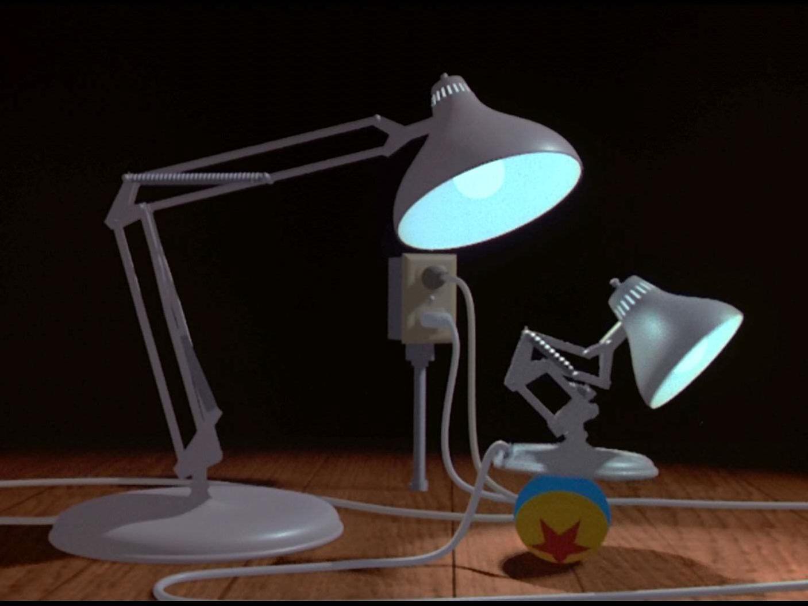




PIXAR – Luxo Jr. (1986)

Slide 5
Requirement 1
General knowledge. Do the following:
In your own words, describe to your counselor what animation is.
Discuss with your counselor a brief history of animation.

Slide 6

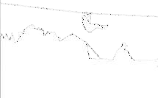
Requirement
1
The technique of photographing successive drawings or positions of puppets or models to create an illusion of movement when the movie is shown as a sequence.
-- google.com
What is
Animation?
A simulation of movement created by displaying a series of pictures or frames.
-- webopedia.com

Slide 7

Requirement
1
Read the following URL’s and return in 2 weeks to discuss
History of Animation
http://www.encyclopedia.com
/topic/Animation.aspx
https://en.wikipedia.org
/wiki/History_of_animation

Slide 8
Requirement 2
Principles of animation. Choose five of the following 12 principles of animation, and discuss how each one makes an animation appear more believable:
squash and stretch (2:35)
anticipation (2:35)
staging (2:50)
straight-ahead action and pose to pose (3:09)
follow through and
overlapping action (2:32)
7. arcs (2:11)
secondary action (2:03)
timing (2:42)
exaggeration (2:04)
solid drawing (2:11)
appeal (2:30)
6. slow in and slow out (2:08)
Total: 29.5 min

Slide 9
Requirement 3
Projects. With your counselor's approval, choose two animation techniques and do the following for each:
Plan your animation using thumbnail sketches and/or layout drawings.
Create the animation.
Share your animations with your counselor. Explain how you created each one, and discuss any improvements that
could be made.

Slide 10
Requirement
3
Choose 2 techniques
Review Your Animations
Return in 2 weeks with your animations and show how they were created using the techniques

Slide 11
Requirement
3
Traditional – Cel animation or hand-drawn: Disney movies
Limited – Less detailed and more stylized, movement more choppy: Cartoons and anime Calvin & Hobbes
Rotoscoping – Trace live-action frame by frame
Stop motion – Move things, take picture, move a little more, repeat
Claymation – Stop motion but used with clay offering more realistic movement
Animation Examples

Slide 12
Requirement
3
Cutout – Paper cutouts and movement with stop motion
Animatronic – Robotic devices that emulate human/animal movements
3D Zoetrope – Circular motion with stobe light
California State Fair
Lego Batman
3D printed sculptures
Animation Examples

Slide 13
Requirement
3
Cell Animation – How to 1 second is hand painted
Flip Book – Post-It sticky notes, notebook, cards, paper pads, or anything with lots of pages
Sports
Superpowers
Animation Examples

Slide 14
Requirement 4
Animation in our world. Do the following:
Tour an animation studio or a business where animation is used, either in person, via video, or via the Internet. Share what you have learned with your counselor.
Discuss with your counselor how animation might be used in the future to make your life more enjoyable and productive.

Slide 15
Requirement
4
Watch these videos
Afterward each person will need to share something they learned about the business of animation
Studio Tour
Pixar Animation Studios – part 1 (5:49)
Pixar Animation Studios – part 2 (5:54)
Pixar Animation Studios – part 3 (6:52)
DreamWorks Studio (3:47)
Technology Behind “How to Train Your Dragon 2” (4:18)
Massive Crowd Software (4:38)
Massive Software Demo Reel (3:07)

Slide 16
Requirement
4
Unreal Engine getting you 90% of the way there
Future Of Animation
Help us understand big data
http://www.fastcodesign.com/3 045291/what-killed-the- infographic#4
Augmented reality - http://www.businessinsider.com
.au/disney-augmented-reality-
2015-10

Slide 17
Requirement 5
Careers. Learn about three career opportunities in animation. Pick one and find out about the education, training, and experience required for this profession. Discuss your findings with your counselor. Explain why this profession might interest you.

Slide 18
Requirement
5
Pick 1 from what we will review and return with your findings
Animation, Art, Editorial, Sound, Operations, Finance, HR, Admin, Legal, Marketing, Post Production, Production, Publicity, RenderMan, Software Research & Development, Story, Technical Artists, Casting, …
http://www.pixar.com/careers
http://www.animationcareerrevie w.com/careers-animation/types- jobs
Careers

Slide 19

My Contact Info
EMAIL: ray@ritch.net
965 Aster Ln
Fernley, NV 89408
http://www.encyclopedia.com
/topic/Animation.aspx
https://en.wikipedia.org
/wiki/History_of_animation

